Slide 1




GIT & GITHUB
Version control system

Slide 2

Agenda
Version Control – What & Why?
Version Control Tools
GitHub & Git
Git Features
Git Operations & Commands

Slide 3
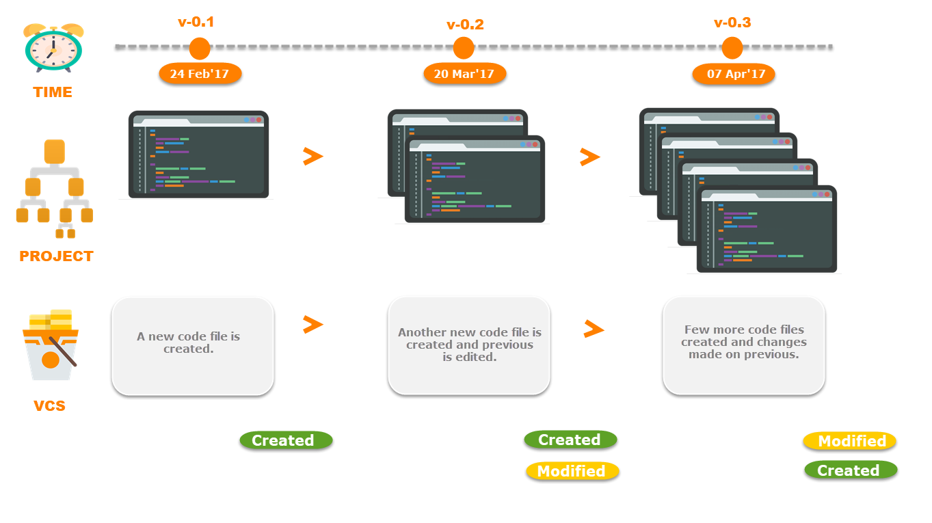
What is Version Control?
Time
1st Time
2nd Time
3rd Time
Changes

Slide 4
What is Version Control?
v 1.0
v 2.0
v 3.0

Slide 5
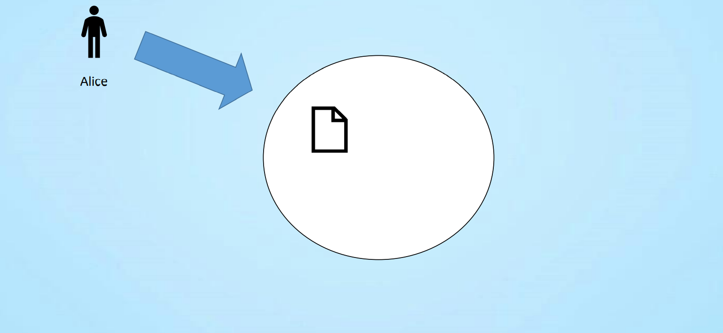
Why Version Control?

Slide 6
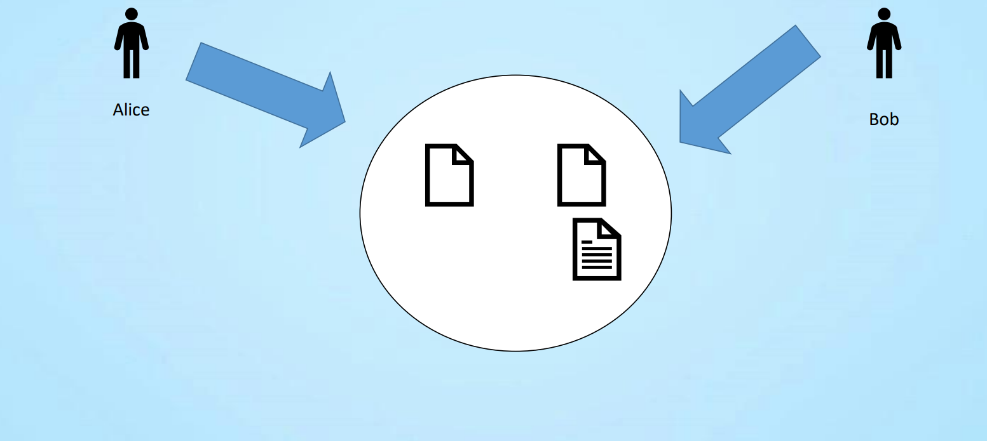
Why Version Control?

Slide 7
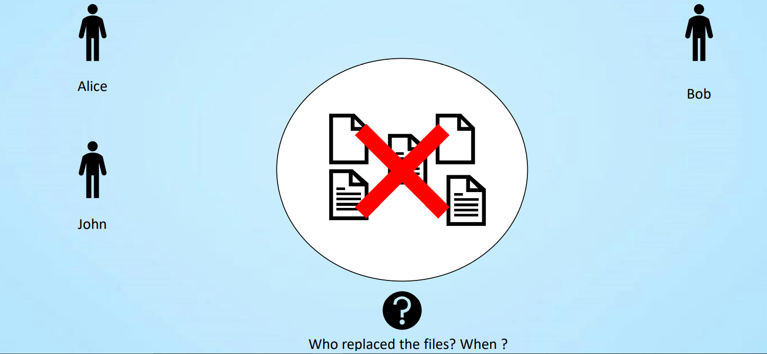
Why Version Control?
Who made the changes ?
What has changed (added, removed, moved)?
Where is the changes applied?
When was the changes made?
Why was the changes made?

Slide 8
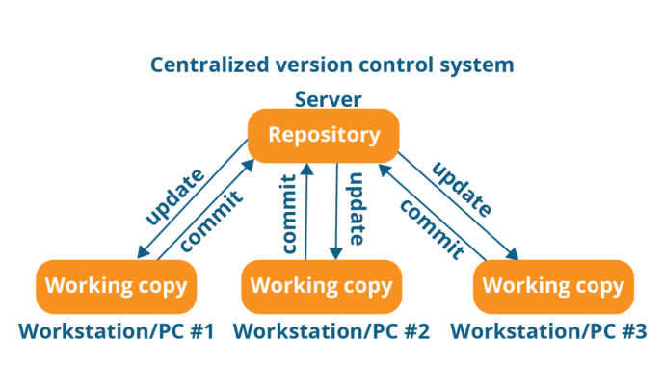
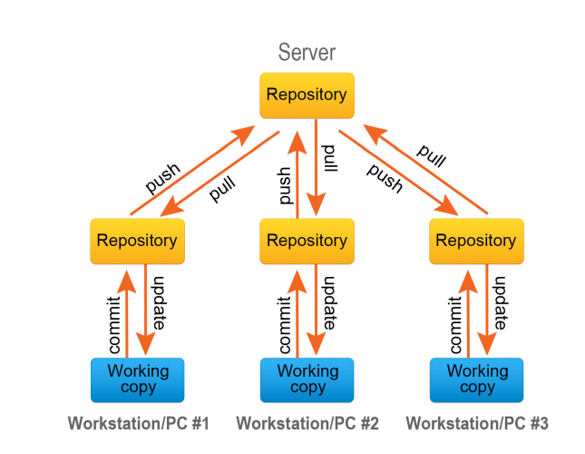
Version Control System
Centralised Version Control System
Distributive Version Control System

Slide 9
SCM (source code management)
Save Time
Track Changes
Increase Productivity
Undo Mistakes
Offline Working

Slide 10

Version Control Tools

Slide 11
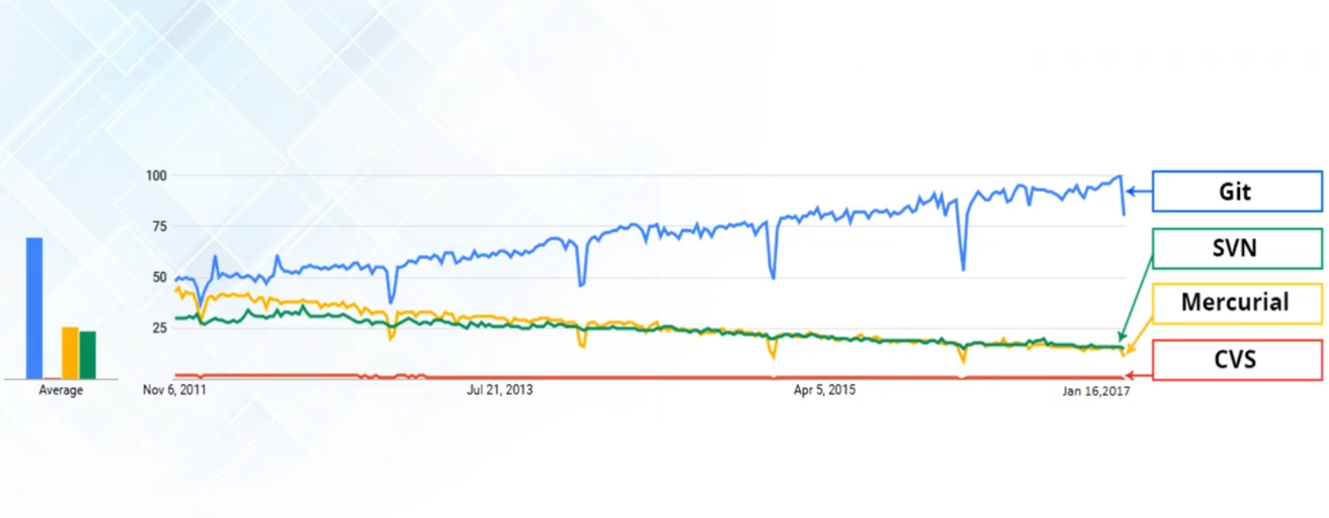
Version Control Tools
Git
Open Source
Speed
Security
Compatibility
Easy to Use
Large Community

Slide 12
Installation & Setup
Download git https://git-scm.com/downloads
Learn More
Free online book https://git-scm.com/book/en/v2
Reference page for git https://services.github.com/index.html
Git for Computer Scientist https://eagain.net/articles/git-for-computer-scientists/

Slide 13
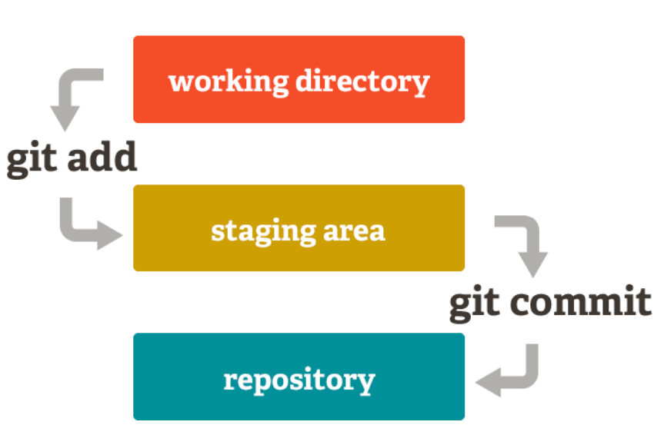
Git Terminology

Slide 14
Git Commands
git add
git diff
git status
git commit
git push
git branch
git checkout
git merge

Slide 15
Git Branching
master
test

Slide 16
Git Branching
git branch
git checkout
git merge

Slide 17
GitHub
Development Platform
Manage Projects
Review Codes
Build Software
Safe

Slide 18
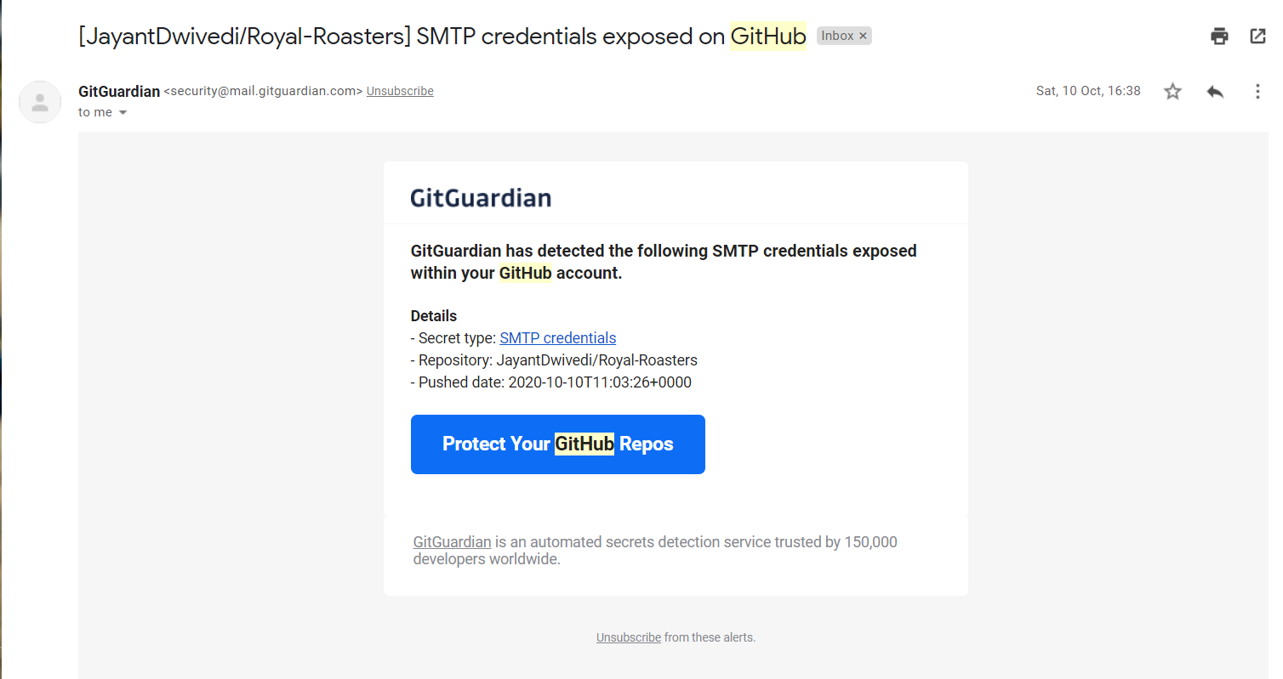
Git Gaurdian

Slide 19
GitHub
Fork
Clone
Issue
Pull Request
GitHub Pages

Slide 20
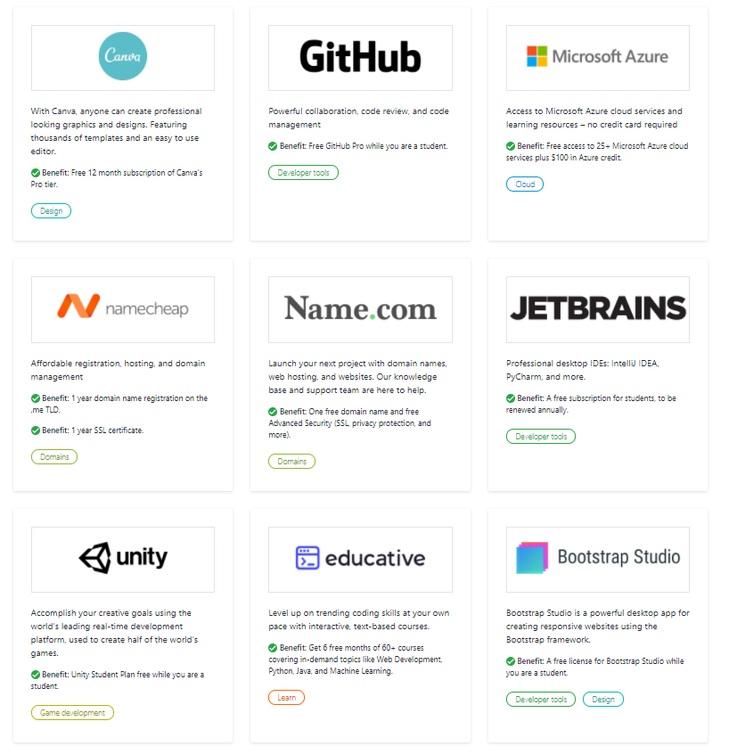
GitHub Education Pack
If you register by your university email id https://education.github.com/pack

Slide 21
Any Questions?

Slide 22
Stay Safe, Healthy
&
Happy
Thank You!

